Slide 1
Job Market Analysis
Project PRDA-04

Slide 2
Project Overview
Dataset: Data science job postings, 742 rows and 42 columns, with a separate Skills table linked to it.
Goal: Understand where data science jobs are, which companies and industries hire, what roles pay, and which skills employers ask for.
Output: Three dashboards built in Power BI, each with filters, plus insights and suggestions for a hiring company.
Dashboard 1
Job Market Overview
Dashboard 2
Salary Analysis
Dashboard 3
Skills Analysis

Slide 3
What the Dashboards Cover
Job Market Overview
Salary Analysis
Skills Analysis
Top state and most common job title
States with the most jobs
Top industries hiring
Companies with most openings
Job titles with most postings
Filters for job title, location, company and industry
Average salary and highest paying job title
Average minimum and maximum salary by state
Average salary by state (map)
Average salary by job title
Average salary by education level (bar chart)
Filters for job title, location, degree and industry
Most requested skill (Python)
Total job postings (742)
Skills required by job title
Key insights and suggestions
Filters for job title, location, company and industry

Slide 4
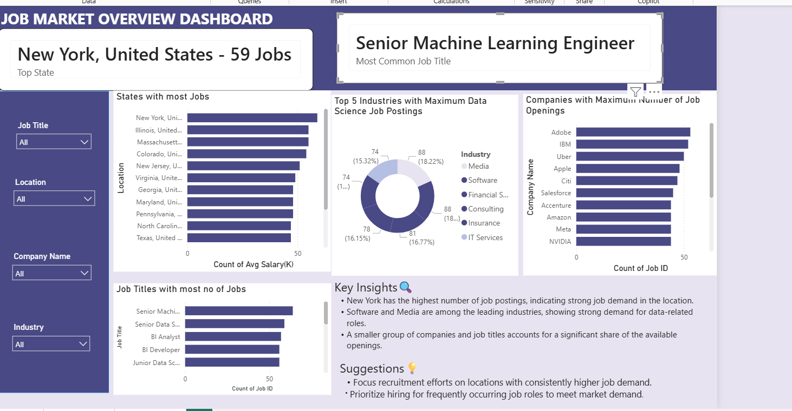
Dashboard 1: Job Market Overview

Slide 5
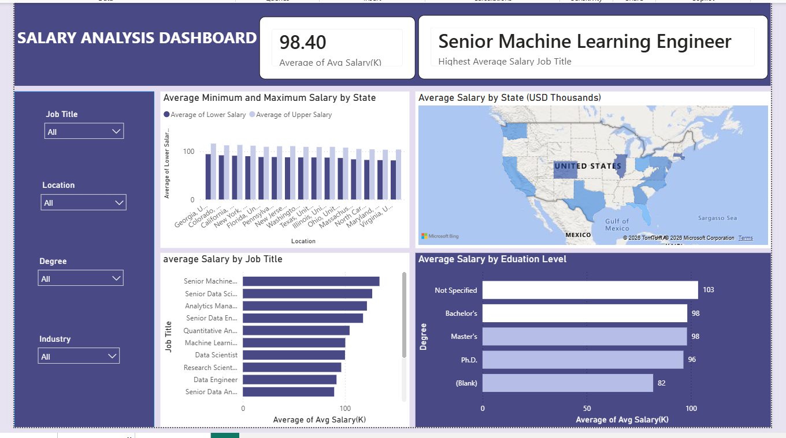
Dashboard 2: Salary Analysis

Slide 6
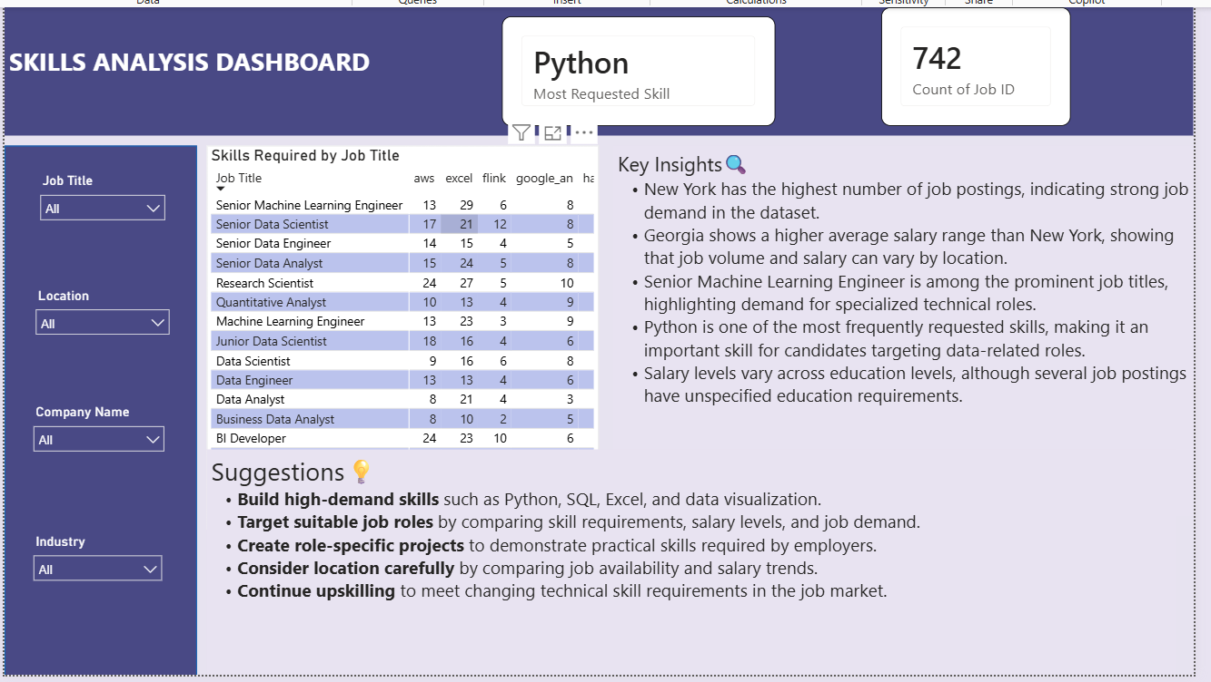
Dashboard 3: Skills Analysis

Slide 7
Key Insights
New York has the most job postings, which points to strong demand in that location.
Software and Media are among the leading industries hiring for data-related roles.
Adobe, IBM and Uber have the most openings, and Senior Machine Learning Engineer is the most common job title.
Georgia has the highest average salary, so the state with the most openings is not the one that pays the most.
Salary varies by state, job title and education level.
Python is the most requested skill, and skill requirements differ by job title.
Looking at salary and skills together shows which skills are in demand and where pay is competitive.

Slide 8
Suggestions to the Company
Focus recruitment on locations with consistently higher job demand.
Prioritise hiring for frequently occurring roles such as Senior Machine Learning Engineer and Senior Data Scientist.
Offer competitive salaries based on job role, location, skills and market demand.
Prioritise candidates with in-demand skills such as Python, SQL, Excel and data visualization.
Provide role-specific training and upskilling to address skill gaps.
Review salary ranges and skill requirements regularly to stay aligned with the market.
Use the salary and skill data together when planning hiring, training and workforce needs.

Slide 9
Thank You

